Slide 2
Button
Div na magiging modal
javascript

Slide 4
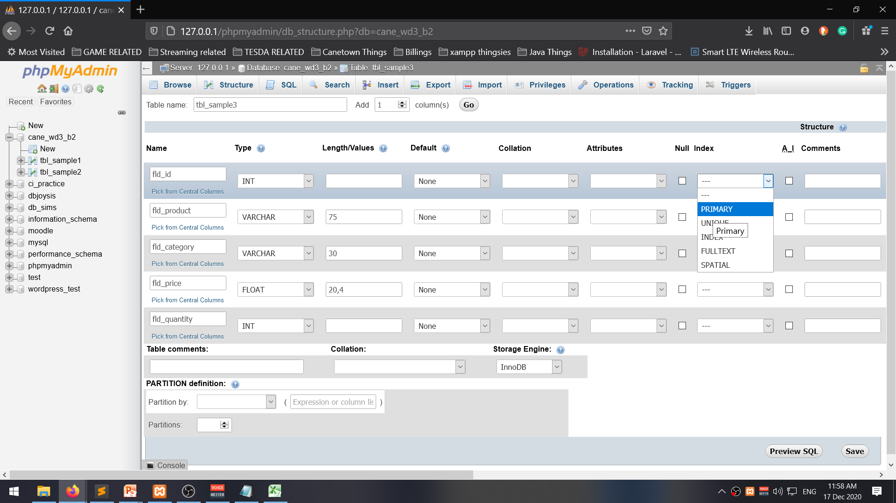

Slide 5
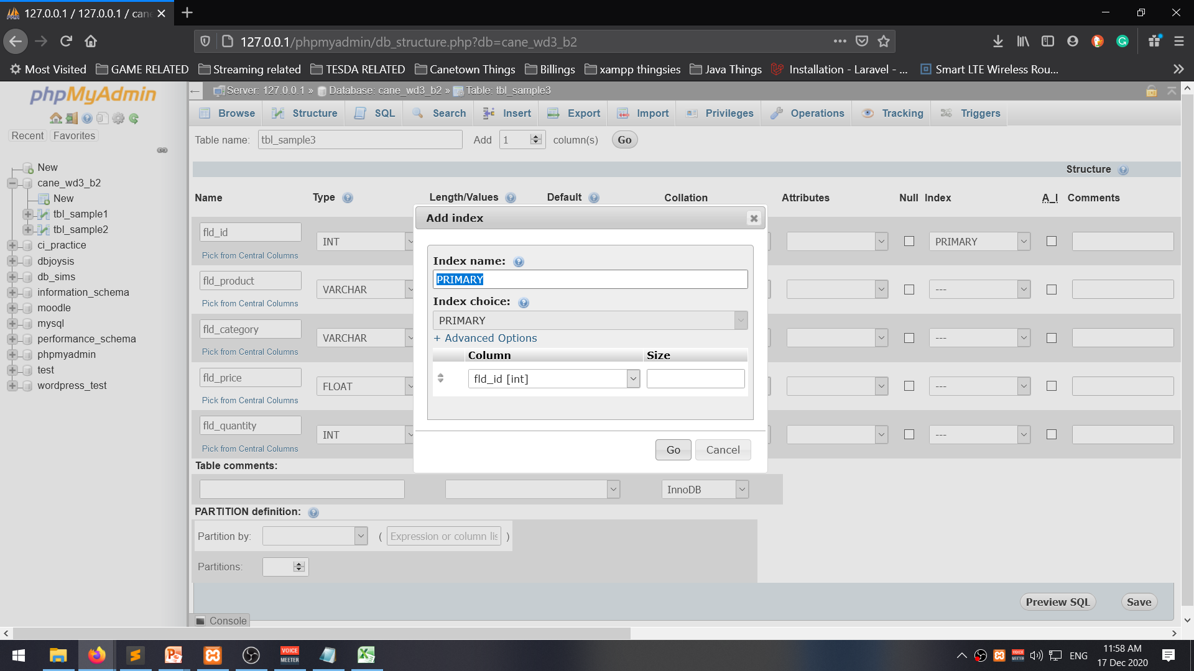

Slide 6
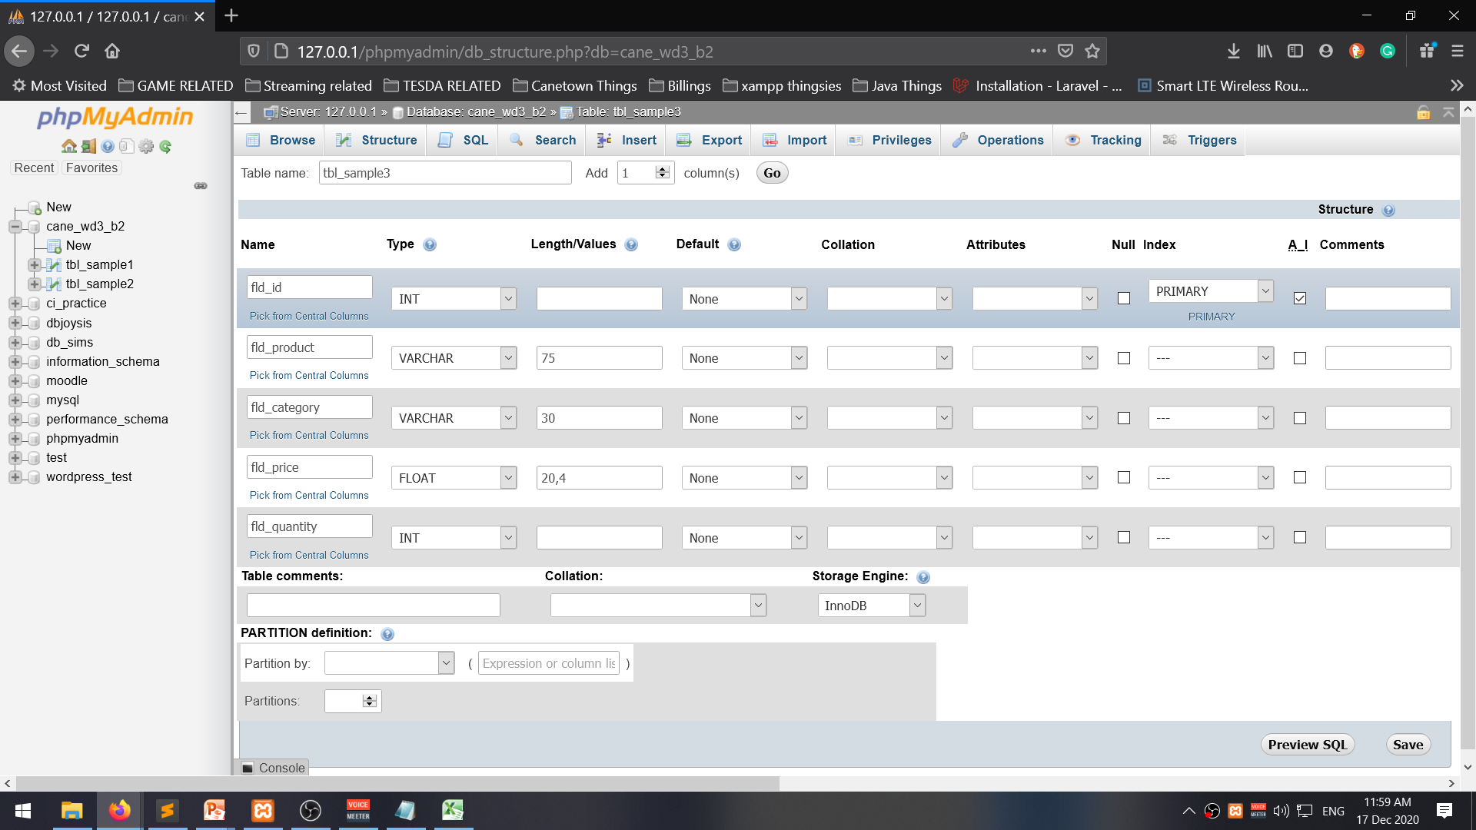
ai = Auto-Increment

